Slide 1
INFO215: Week 3a
Privacy (Just a Little)
Facial Recognition
Digital Inequity

Slide 2
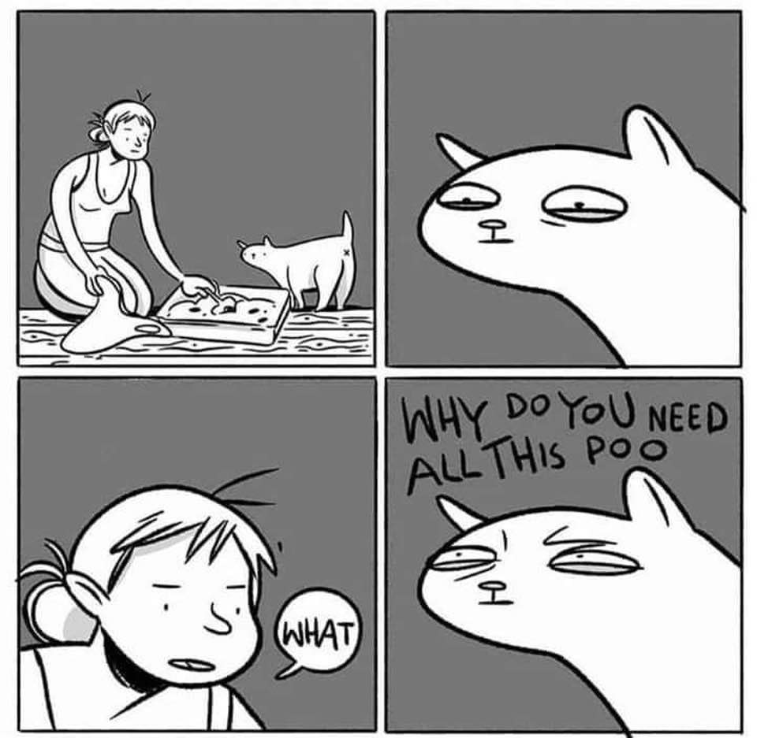
Reflections on privacybadger and ghostery

Slide 3
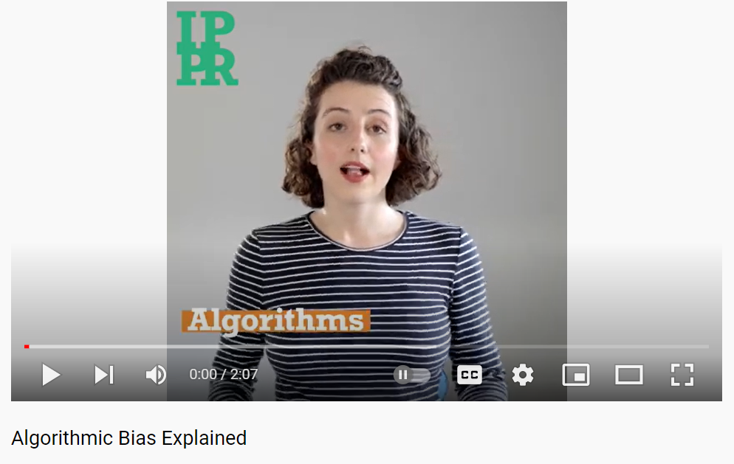
ALGORITHMIC BIAS AND DIGITAL EQUITY
https://www.ippr.org/media-item/watch-algorithmic-bias-explained
What’s the connection between algorithmic bias and our discussion on technology for a good society?

Slide 4
What does this have to do with “information”?
Why Did I Say that
“Data” = “Representations of Phenomena”

Slide 5
Let’s Watch a Little Movie: https://www.youtube.com/watch?v=gkbNH39QE0Q

Slide 6
A Civil Debate
Divide up into pro- con- groups ☺ (Some may have to play devil’s advocate)
Consider Facial Recognition in Different Circumstances:
- Has it been positive? Negative? In what ways?
In what ways has the social context in which the technology is used changed as a product of the tech?
For future technologies: How can we ensure that they support the values of a good society?

Slide 7
The World We Inherit
This is us. This is where we are.
Notes:
Who is ‘us’ who is ‘we’?

